Slide 1

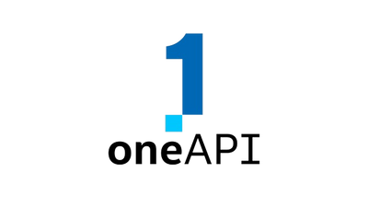

INTEL® GEN AI HACKATHON
LazyCoders

Slide 2

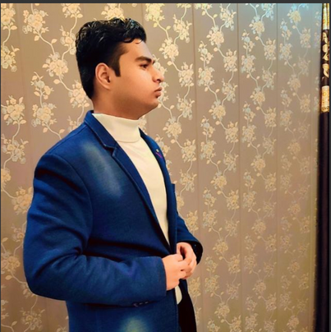
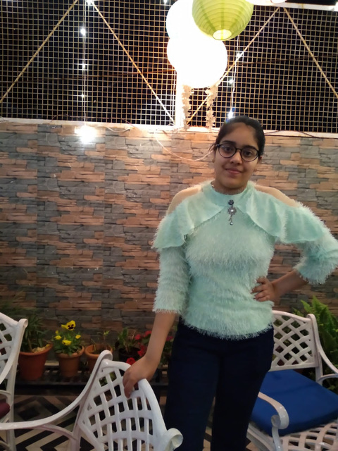
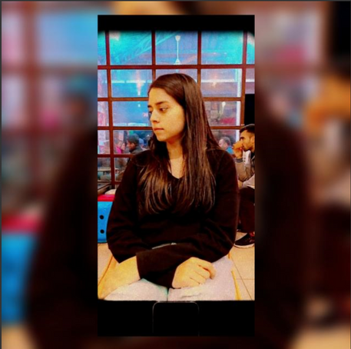
MEET OUR
TEAM MEMBERS
DHAIRYA MAHESHWARI
ISHIKA BANSAL
SVATI PRIYA

Slide 3

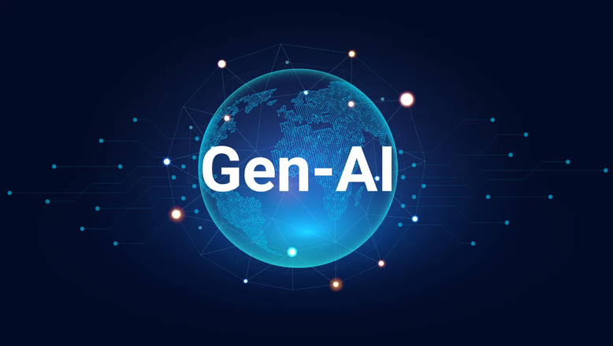
PROBLEM
STATEMENT
The problem statement for home remedies are prescribed below:
•"Feeling under the weather and looking for natural remedies to alleviate cold and flu symptoms?"
•"Dealing with pesky acne outbreaks and inneed of gentle yet effective skincare remedies?“
•"Experiencing digestive discomfort and seeking natural solutions to ease bloating and indigestion?"
• "Suffering from seasonal allergies and searching for home remedies to soothe irritated sinuses and relieve congestion?"
•"Tired of battling persistent headaches and interested in exploring natural remedies for headache relief?"
• "Seeking natural remedies to boost immunity and support overall wellness duringcold and flu season?"

Slide 4
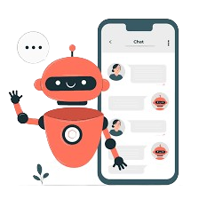
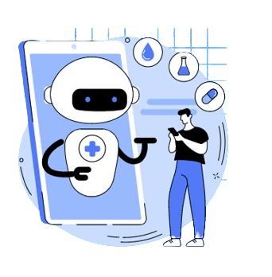

ABOUT
CURECRAFTERS
CureCrafters is the “Home Remedies Chat Bot” which is a web-based platform designed to provide users with personalized home remedy recommendations for various symptoms. The system not only offers a user-friendly chat bot interface for symptom analysis and remedy suggestions but also includes a robust data management system to store user information.

Slide 5

WHAT WE GONNA
OFFER
Provide users with tailored advice and recommendations for natural remedies based on their specific health or household concerns.
Personalized Guidance
1
2
Offer immediate and convenient access to information, empowering users to explore home remedies anytime, anywhere, reducing dependence on traditional research methods.
Accessibility
Encourage users to take an active role in their well-being by promoting self-care through natural and holistic approaches, fostering a sense of control over minor health issues.
Health Empowerment
3
Provide valuable insights and educational content about the benefits, applications, and precautions associated with various home remedies, enhancing users’ understanding of natural alternatives for a healthier lifestyle.llness Education
4
Wellness Education

Slide 6
OUR FUTURE
1
PROJECT
Personalized Health Profiles
Planning for the future of a home remedies chatbot website means thinking about how to make it better for users as things change. We need to think about how it can grow and adapt to keep up with what people need.
2
Enhanced User Engagement Features
3
Expansion of Remedies Database
Integration with Wearable Devices and Health Apps
4

Slide 7

OUR CURECRAFTER
FEATURES
1
User Registration and Profiles: Users can registerwith uniquecredentials and create/update their profiles withpersonal information.
Creating a chatbot website focused on home remedies can be incredibly useful for providing users with quick and accessible information on natural remedies for common health issues.
2
Symptom Input and Analysis: The chat botprompts usersto inputsymptoms, and the system analyze the inputto identifyrelevant conditions.
3
Remedy Recommendations: Personalized home remedy suggestions are provided based on the symptoms entered by the user.

Slide 8
PROCESS FLOW
User Initiation: The user visits the website and initiates interaction with the chatbot by typing a query or selecting predefined options.
1
4
Recommendation Generation: The chatbot generates personalized recommendations based on the user's query and context.
Query Understanding: The chatbot uses natural language processing (NLP) algorithms to understand the user's query or intent.
2
5
Response Delivery: The chatbot presents the recommended remedies to the user in a clear and concise manner.
Information Retrieval: Based on the user's query, the chatbot retrieves relevant information from its database of home remedies.
3
6
Closure or Exit: Once the user's query has been addressed satisfactorily, the interaction with the chatbot may be concluded.

Slide 9




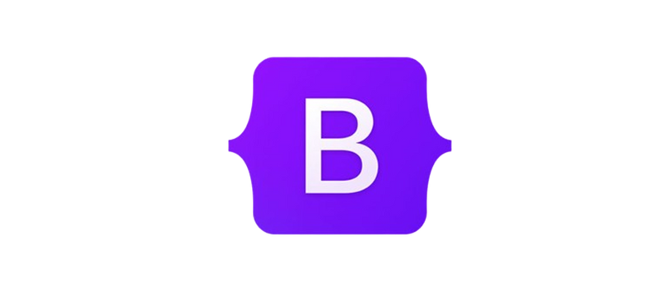



TECHNOLOGIES USED
For Frontend:
For the frontend of the website, we HTML (for structuring the website), CSS (for styling the website), and JavaScript (for adding the logics to the websites) by these technologies we made our website’s frontend attractive and interactive.
For Backend:
For linking our website to the database and perform the backend tasks we use Node.js and Express.js. These technologies ensure the smooth working of our website.
Database:
For storing the data of user, symptoms and remedies we use PostgreSQL or MongoDB as our database.
For Chat Bot:
For making and training the chat bot we use Intel oneAPI ToolKit from which we use Intel Extension for Pytorch (ipex).
For Chatbot API:
For making our chatbot API live we use Render.

Slide 10
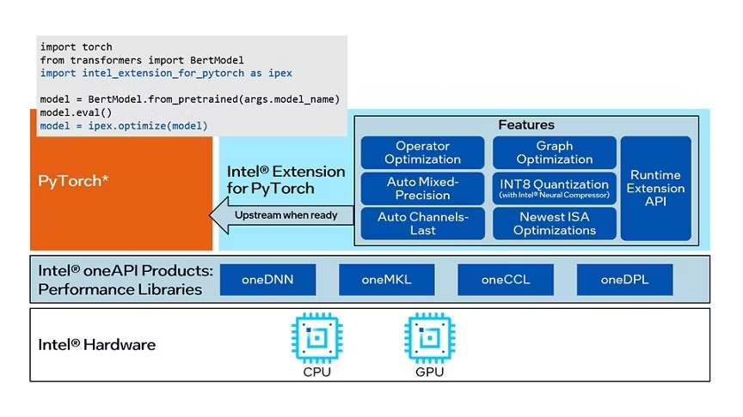
INTEL® EXTENSION FOR PYTORCH
Intel Extension for PyTorch* extends PyTorch with optimizations for extra performance boost on Intel hardware. Most of the optimizations will be included in stock PyTorch releases eventually, and the intention of the extension is to deliver up to date features and optimizations for PyTorch on Intel hardware, examples include AVX-512 Vector Neural Network Instructions (AVX512 VNNI) and Intel® Advanced Matrix Extensions (Intel® AMX).
Architecture

Slide 11
FEATURES OF:
INTEL® EXTENSION FOR PYTORCH
Intel® Extension for PyTorch* provides simple frontend Python APIs and utilities for users to get performance optimizations such as graph optimization and operator optimization with minor code changes. Typically, only 2 to 3 clauses are required to be added to the original code.
1
Ease-of-use Python API
2
Low precision data type BFloat16 has been natively supported on the 3rd Generation Xeon scalable Servers (aka Cooper Lake) with AVX512 instruction set and will be supported on the next generation of Intel® Xeon® Scalable Processors with Intel® Advanced Matrix Extensions (Intel® AMX) instruction set with further boosted performance.
Auto Mixed Precision (AMP)
To optimize performance further with torchscript, Intel® Extension for PyTorch* supports fusion of frequently used operator patterns, like Conv2D+ReLU, Linear+ReLU, etc. The benefit of the fusions are delivered to users in a transparent fashion.
3
Graph Optimization
4
Intel® Extension for PyTorch* also optimizes operators and implements several customized operators for performance. A few ATen operators are replaced by their optimized counterparts in Intel® Extension for PyTorch* via ATen registration mechanism.
Operator Optimization

Slide 12
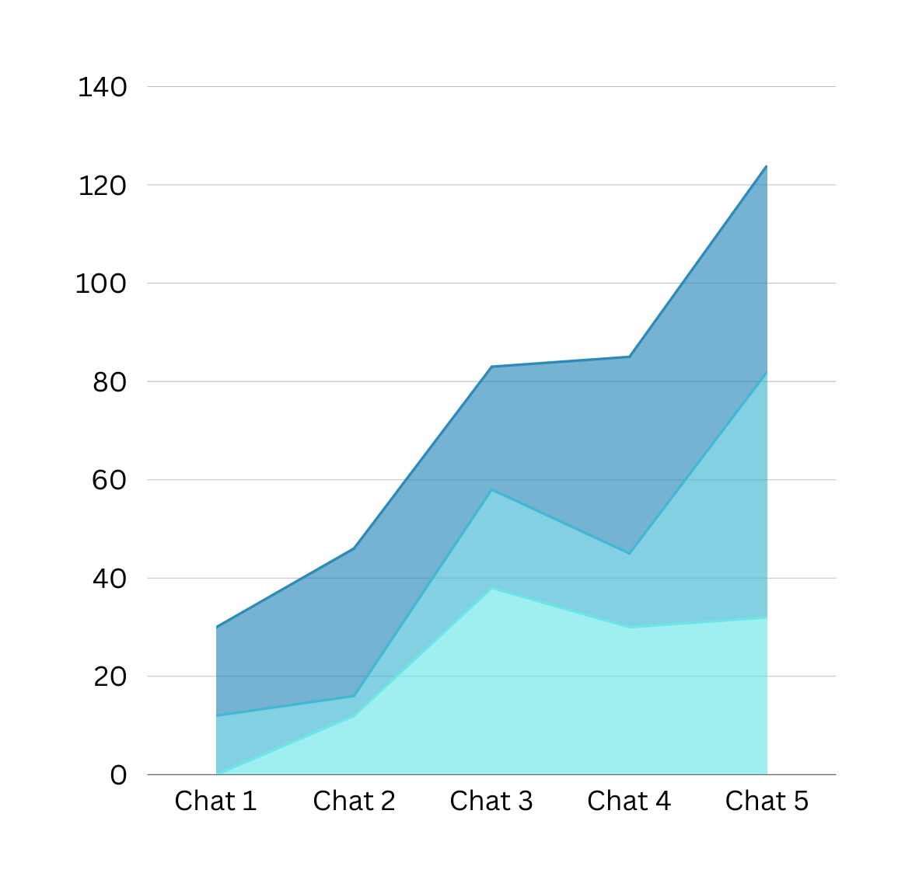

RESULT
As user accessibility with the chatbot expands, the landscape of errors undergoes a metamorphosis, shrinking into mere whispers amidst the crescendo of accuracy. Our journey intertwines with the chatbot's capabilities, forging a pathway where accessibility acts as the catalyst for error reduction, ushering in an era where precision reigns supreme.

Slide 13

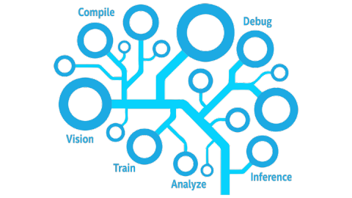
USE CASE OF
INTEL® DEVELOPER CLOUD (IDC)
Improved Performance:
Issue: The chatbot website experiences sluggish performance during peak usage hours, leading to delays in response times.
Solution: By integrating Intel IDC, the website's processing power and efficiency are boosted, resulting in faster response times and smoother interactions even during high traffic periods.
Enhanced User Experience:
Issue: Users often encounter delays or unresponsiveness when interacting with the chatbot, leading to frustration.
Solution: Intel IDC enhances the chatbot's responsiveness and overall performance, providing users with a seamless and engaging experience when seeking home remedies or health advice.
Scalability and Reliability:
Issue: The website struggles to handle sudden spikes in user traffic, leading to service disruptions and downtime.
Solution: With Intel IDC, the website gains the ability to dynamically scale resources based on demand, ensuring consistent performance and reliability even during peak periods of activity.
Optimized Resource Utilization:
Issue: The website's current infrastructure consumes excessive resources, resulting in inefficiencies and increased operational costs.
Solution: Intel IDC optimizes resource utilization by efficiently allocating processing power and system resources, reducing energy consumption and operational expenses while maintaining optimal performance levels.

Slide 14

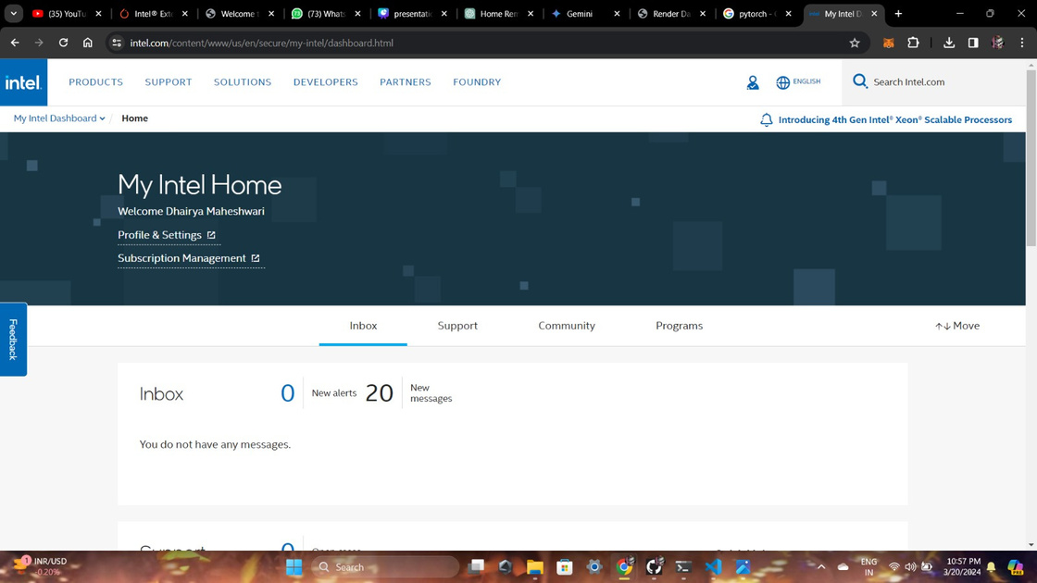
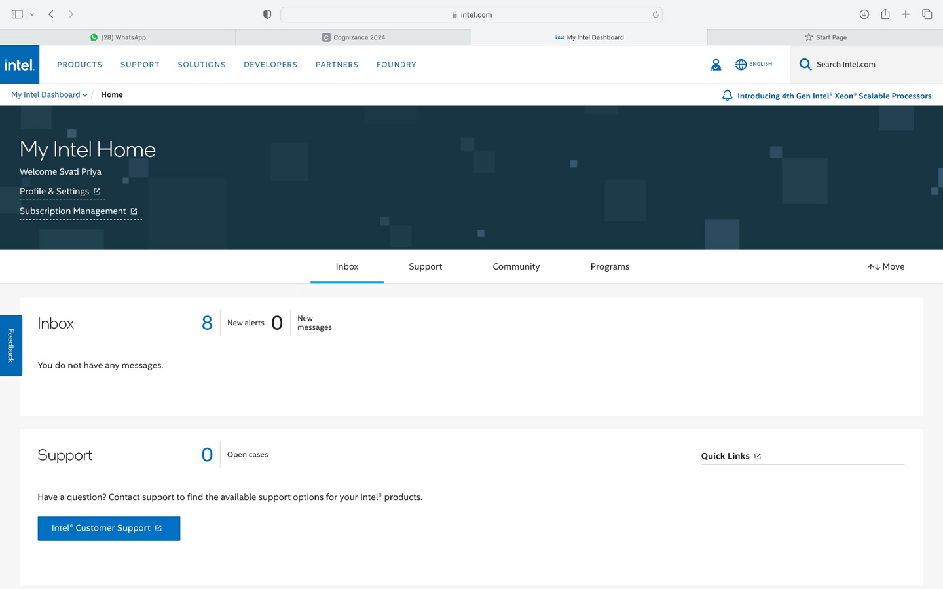
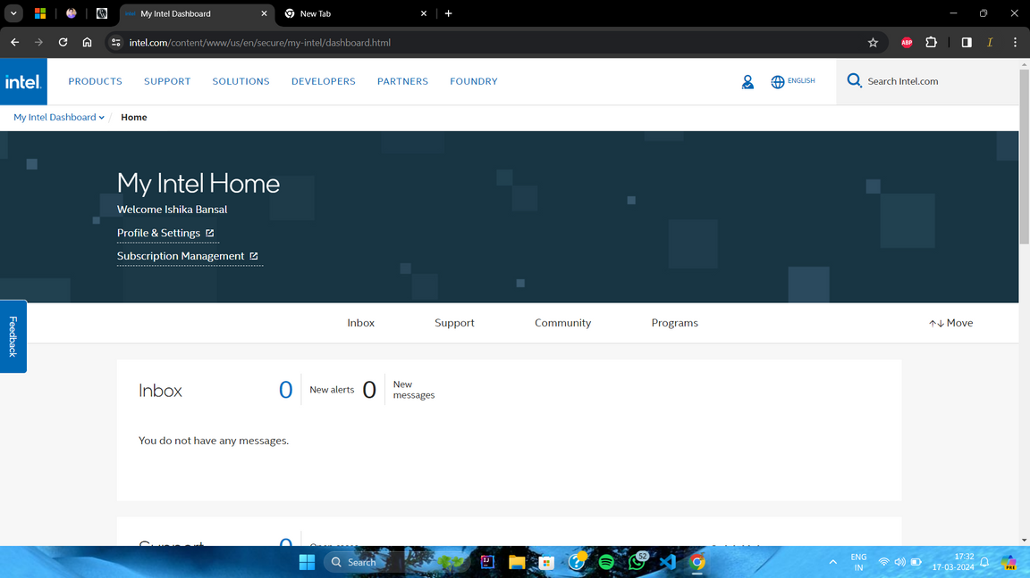
INTEL® DEVELOPER CLOUD ACCOUNT (SCREENSHOT)

Slide 15

THANK YOU
Github Repo Link :
https://github.com/Dhairya931/Cure-Crafter.git
VISIT US

